Slide 1


欢迎大家来敬拜神
请关掉手机
入坐后以安静的心等候神
Welcome to NCBC Worship Service
Please turn off your cellphone, be seated
and wait quietly upon our Lord

Slide 2

诺福克华人浸信会
主日崇拜
Norfolk Chinese Baptist Church
Sunday Worship Service

Slide 3
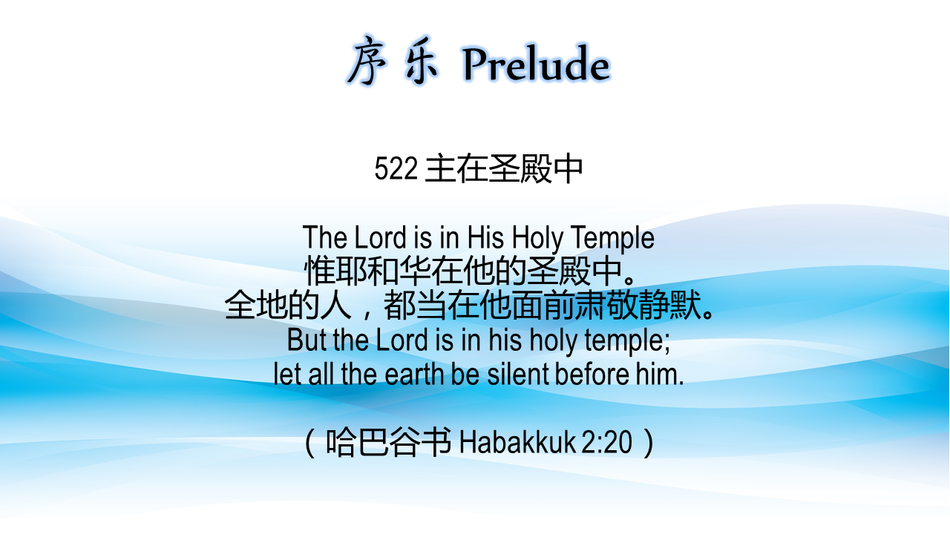
序乐 Prelude
522 主在圣殿中
The Lord is in His Holy Temple
惟耶和华在他的圣殿中。
全地的人，都当在他面前肃敬静默。
But the Lord is in his holy temple;
let all the earth be silent before him.
（哈巴谷书 Habakkuk 2:20）

Slide 4


Slide 5
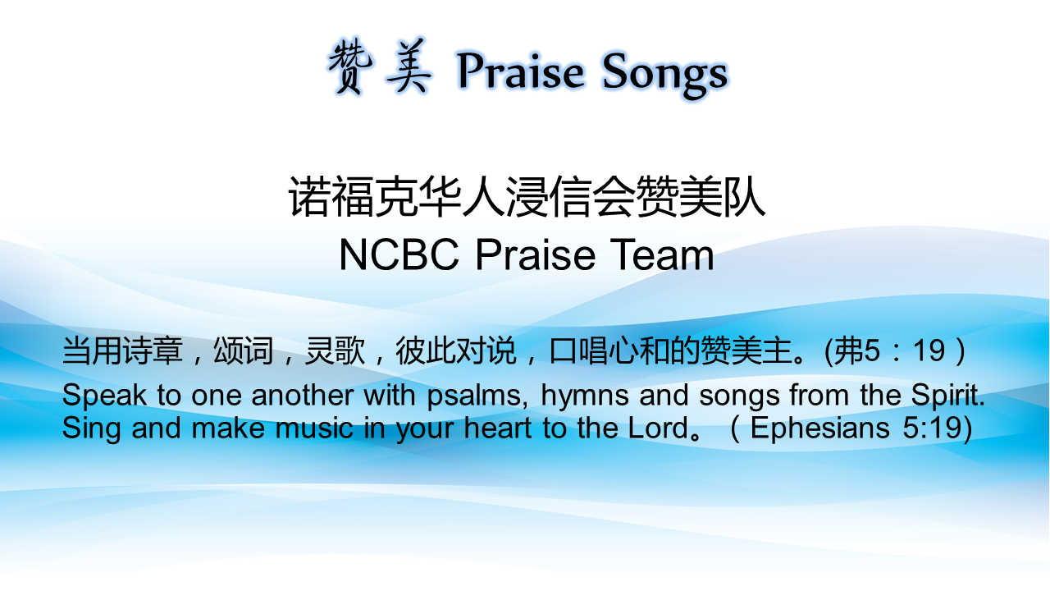
赞美 Praise Songs
诺福克华人浸信会赞美队
NCBC Praise Team
当用诗章，颂词，灵歌，彼此对说，口唱心和的赞美主。(弗5：19）
Speak to one another with psalms, hymns and songs from the Spirit. Sing and make music in your heart to the Lord。（Ephesians 5:19)

Slide 6
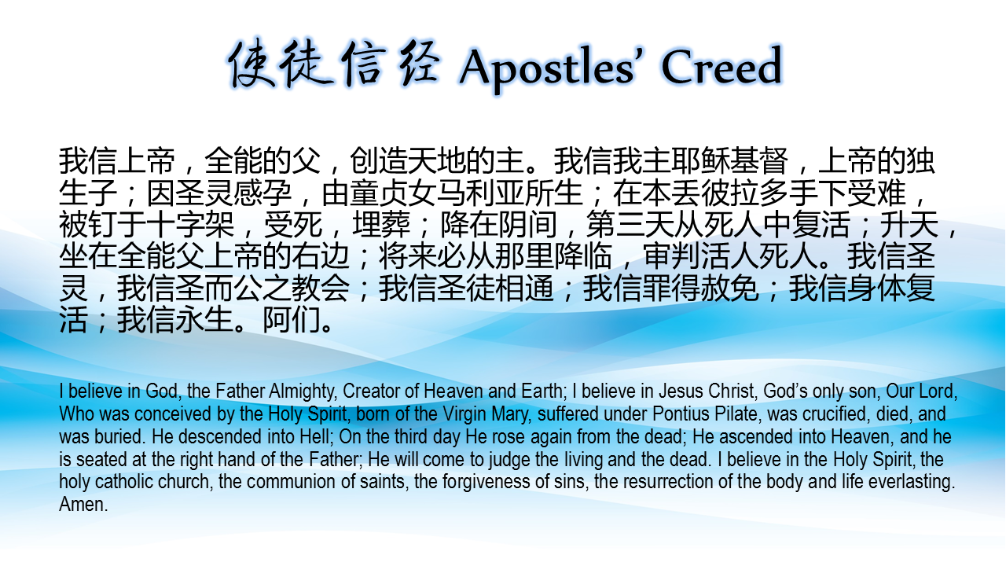
使徒信经 Apostles’ Creed
我信上帝，全能的父，创造天地的主。我信我主耶稣基督，上帝的独生子；因圣灵感孕，由童贞女马利亚所生；在本丢彼拉多手下受难，被钉于十字架，受死，埋葬；降在阴间，第三天从死人中复活；升天，坐在全能父上帝的右边；将来必从那里降临，审判活人死人。我信圣灵，我信圣而公之教会；我信圣徒相通；我信罪得赦免；我信身体复活；我信永生。阿们。
I believe in God, the Father Almighty, Creator of Heaven and Earth; I believe in Jesus Christ, God’s only son, Our Lord, Who was conceived by the Holy Spirit, born of the Virgin Mary, suffered under Pontius Pilate, was crucified, died, and was buried. He descended into Hell; On the third day He rose again from the dead; He ascended into Heaven, and he is seated at the right hand of the Father; He will come to judge the living and the dead. I believe in the Holy Spirit, the holy catholic church, the communion of saints, the forgiveness of sins, the resurrection of the body and life everlasting. Amen.

Slide 7
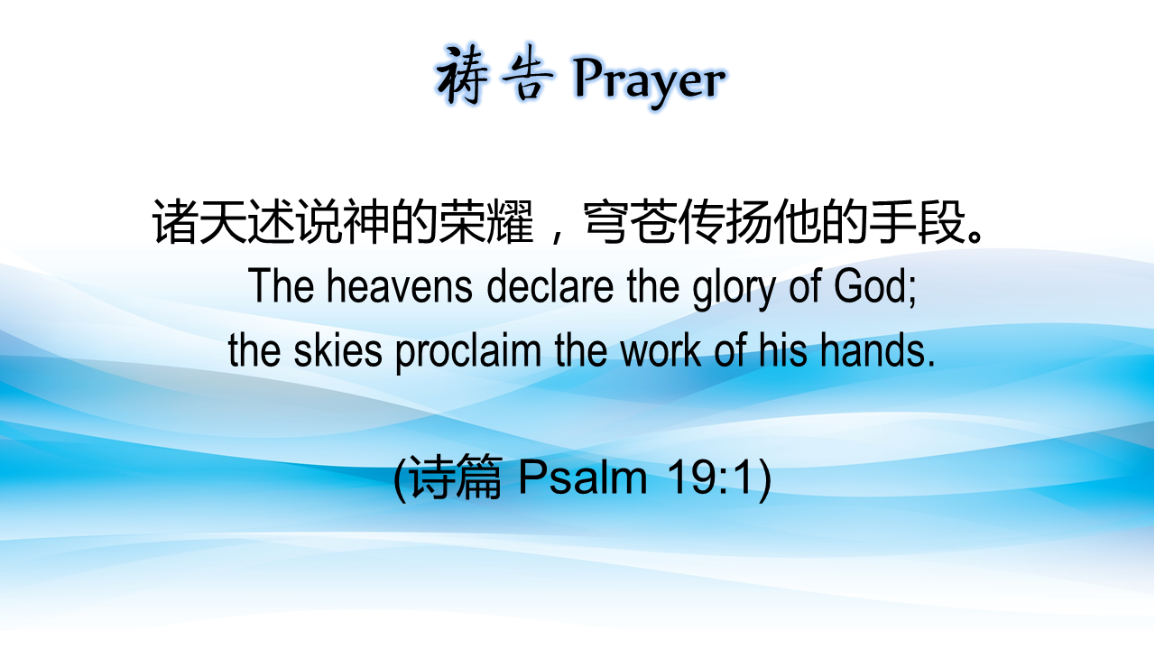
祷告 Prayer

Slide 8


Slide 9
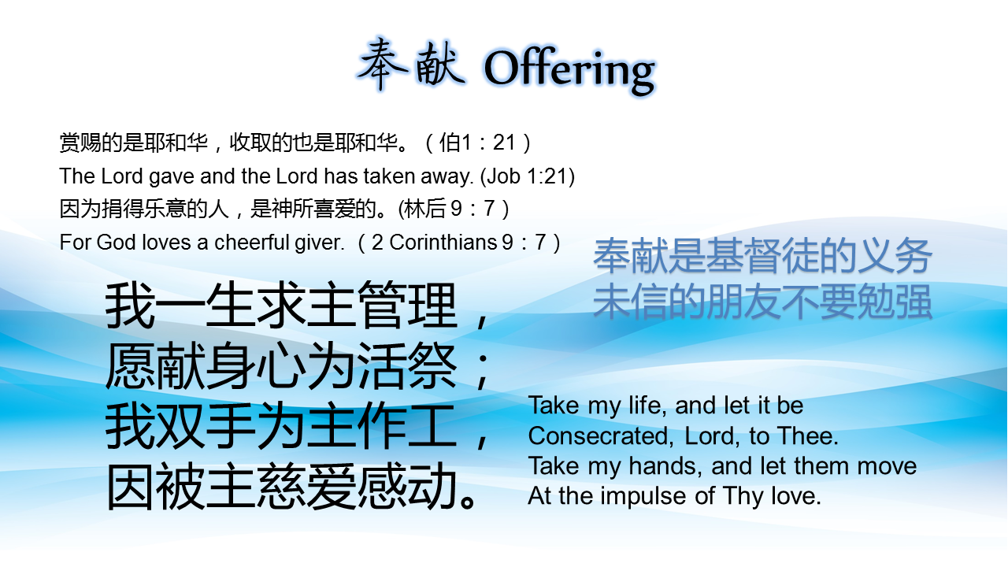
奉献 Offering
赏赐的是耶和华，收取的也是耶和华。（伯1：21）
The Lord gave and the Lord has taken away. (Job 1:21)
因为捐得乐意的人，是神所喜爱的。(林后 9：7）
For God loves a cheerful giver. （2 Corinthians 9：7）
奉献是基督徒的义务
未信的朋友不要勉强
我一生求主管理，
愿献身心为活祭；
我双手为主作工，
因被主慈爱感动。
Take my life, and let it be Consecrated, Lord, to Thee. Take my hands, and let them move At the impulse of Thy love.

Slide 10
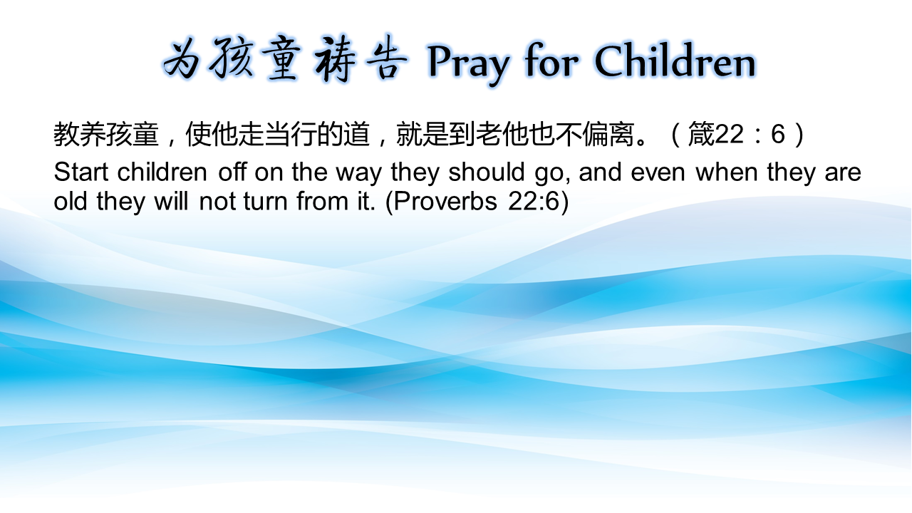
为孩童祷告 Pray for Children
教养孩童，使他走当行的道，就是到老他也不偏离。（箴22：6）
Start children off on the way they should go, and even when they are old they will not turn from it. (Proverbs 22:6)

Slide 11
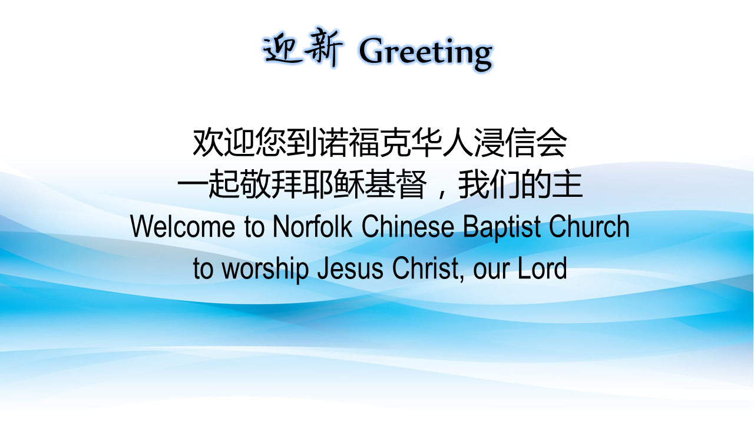
迎新 Greeting
Welcome to Norfolk Chinese Baptist Church
to worship Jesus Christ, our Lord

Slide 12
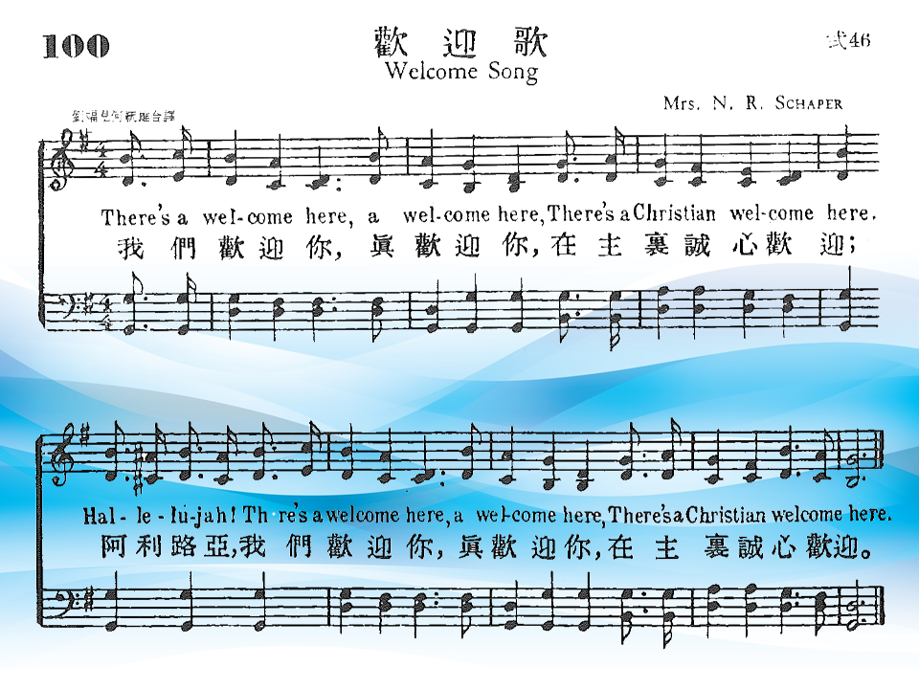

Slide 13


Slide 14


Slide 15


Slide 16
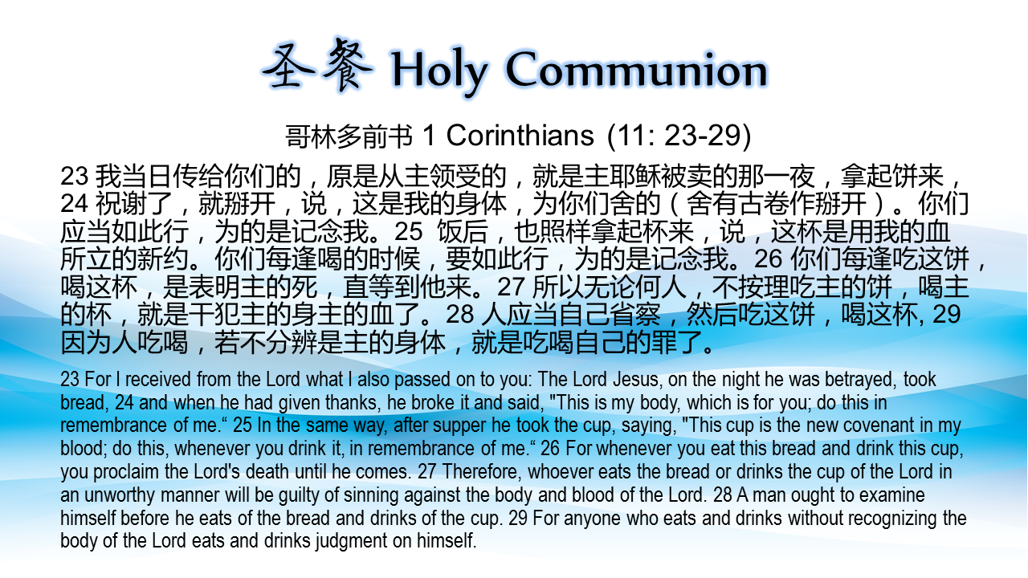
圣餐 Holy Communion
哥林多前书 1 Corinthians (11: 23-29)
23 我当日传给你们的，原是从主领受的，就是主耶稣被卖的那一夜，拿起饼来，24 祝谢了，就掰开，说，这是我的身体，为你们舍的（舍有古卷作掰开）。你们应当如此行，为的是记念我。25 饭后，也照样拿起杯来，说，这杯是用我的血所立的新约。你们每逢喝的时候，要如此行，为的是记念我。26 你们每逢吃这饼，喝这杯，是表明主的死，直等到他来。27 所以无论何人，不按理吃主的饼，喝主的杯，就是干犯主的身主的血了。28 人应当自己省察，然后吃这饼，喝这杯, 29 因为人吃喝，若不分辨是主的身体，就是吃喝自己的罪了。
23 For I received from the Lord what I also passed on to you: The Lord Jesus, on the night he was betrayed, took bread, 24 and when he had given thanks, he broke it and said, "This is my body, which is for you; do this in remembrance of me.“ 25 In the same way, after supper he took the cup, saying, "This cup is the new covenant in my blood; do this, whenever you drink it, in remembrance of me.“ 26 For whenever you eat this bread and drink this cup, you proclaim the Lord's death until he comes. 27 Therefore, whoever eats the bread or drinks the cup of the Lord in an unworthy manner will be guilty of sinning against the body and blood of the Lord. 28 A man ought to examine himself before he eats of the bread and drinks of the cup. 29 For anyone who eats and drinks without recognizing the body of the Lord eats and drinks judgment on himself.

Slide 17
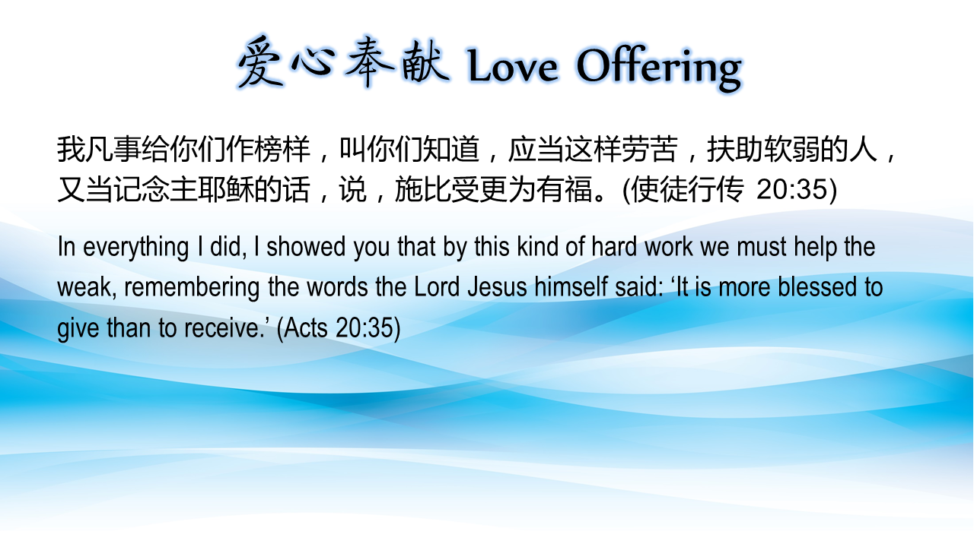
我凡事给你们作榜样，叫你们知道，应当这样劳苦，扶助软弱的人，又当记念主耶稣的话，说，施比受更为有福。(使徒行传 20:35)
In everything I did, I showed you that by this kind of hard work we must help the weak, remembering the words the Lord Jesus himself said: 'It is more blessed to give than to receive.'

Slide 18
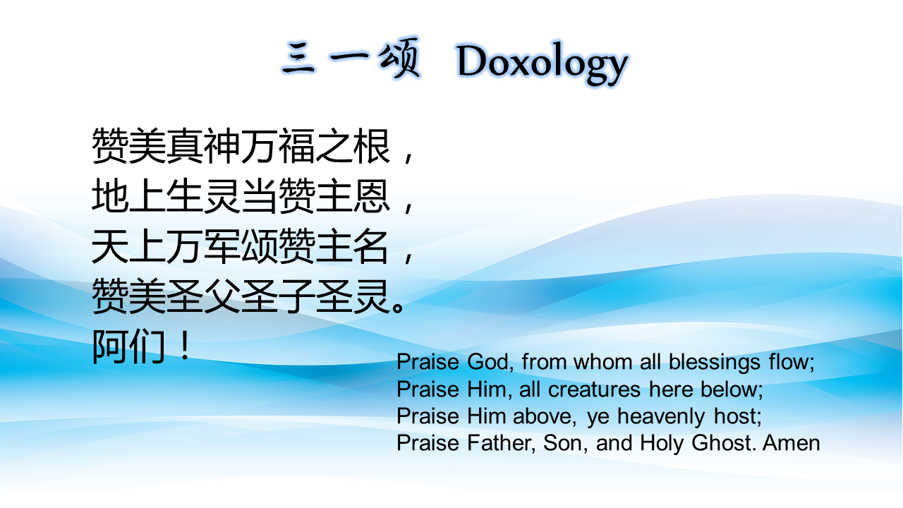
三一颂 Doxology
赞美真神万福之根，
地上生灵当赞主恩，
天上万军颂赞主名，
赞美圣父圣子圣灵。
阿们！
Praise God, from whom all blessings flow;
Praise Him, all creatures here below;
Praise Him above, ye heavenly host;
Praise Father, Son, and Holy Ghost. Amen

Slide 19
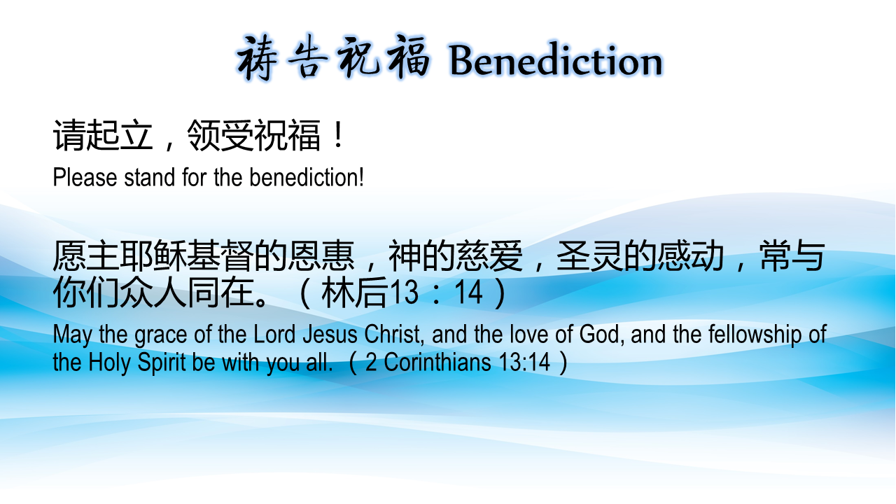
祷告祝福 Benediction
请起立，领受祝福！
Please stand for the benediction!
愿主耶稣基督的恩惠，神的慈爱，圣灵的感动，常与你们众人同在。（林后13：14）
May the grace of the Lord Jesus Christ, and the love of God, and the fellowship of the Holy Spirit be with you all. （2 Corinthians 13:14）

Slide 20
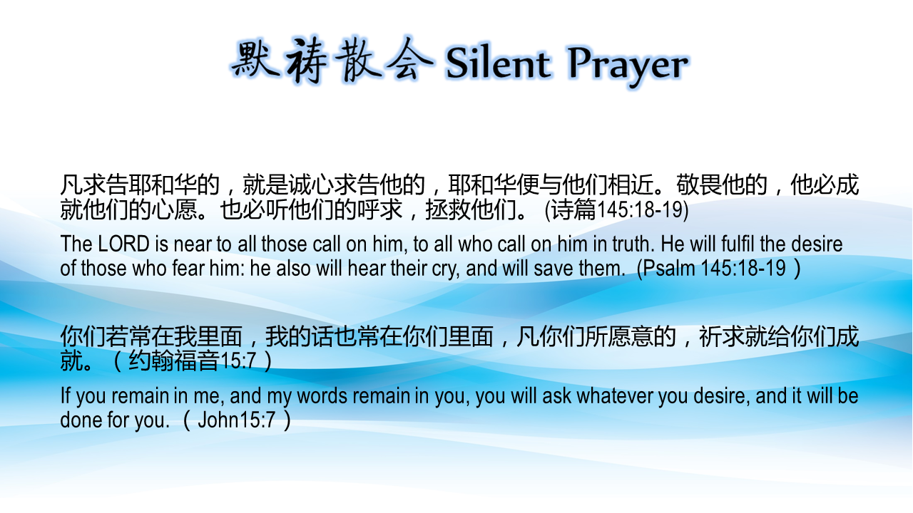

凡求告耶和华的，就是诚心求告他的，耶和华便与他们相近。敬畏他的，他必成就他们的心愿。也必听他们的呼求，拯救他们。 (诗篇145:18-19)
The LORD is near to all those call on him, to all who call on him in truth. He will fulfil the desire of those who fear him: he also will hear their cry, and will save them. (Psalm 145:18-19）
你们若常在我里面，我的话也常在你们里面，凡你们所愿意的，祈求就给你们成就。（约翰福音15:7）
If you remain in me, and my words remain in you, you will ask whatever you desire, and it will be done for you. （John15:7）

